Slide 1

Intelligent Question Answering System for University Policy Documents
By: OBIORA ORAKWUE
20221870
Supervisor: ASSOC. PROF. NOAH AKANDE

Slide 2
Content
Introduction: Background
Problem statement
Gaps in Literature and Existing Systems
Methodology
System Architecture
Module 1
Use case diagram
Module 2
Use case diagram
Technology Stack for Module 1 & 2
Demo
Conclusion and recommendations for future work

Slide 3
Background
University policy documents, such as student handbooks, academic regulations, examination guidelines, and codes of conduct, are essential for academic administration at Nile University.
They provide the official rules, procedures, and guidelines that govern student rights, responsibilities, and academic processes.
These documents are meant to ensure uniformity, clarity, and fairness across the university community

Slide 4
Problem Statement
However, despite their importance, these documents are often lengthy, scattered, and written in formal language. Students and staff struggle to locate specific information quickly. Traditional keyword search fails to understand the real intent behind questions, leading to wasted time, repeated administrative enquiries, and occasional misinformation.

Slide 5
Aim and Objectives
Aim: To develop an Intelligent Question Answering System using Retrieval-Augmented Generation (RAG) with Gemini 2.5 Flash that allows natural language queries on official university policy documents.
Objectives:
To explore existing QA systems and NLP techniques
To preprocess and organize university policy documents
To implement and optimize a RAG architecture
To develop a user-friendly natural language interface

Slide 6
Gaps in Existing Works and Literature
Most QA systems are designed for open-domain (Wikipedia) or general documents, not institutional policy documents.
Very few studies focus on university/academic policies, especially in developing countries like Nigeria.
Pure generative models frequently suffer from hallucinations (fabricating answers).
Traditional keyword search lacks semantic understanding.
Limited practical evaluation using real university policy datasets.

Slide 7
Methodology
Integrated RAG Approach (Single cohesive system)
Adopted Retrieval-Augmented Generation (RAG) methodology.
Document processing pipeline using Python and LlamaIndex.
Retrieval + Generation workflow to ensure answers are grounded in official documents. (No need for multiple methodologies since it is one integrated system)

Slide 8
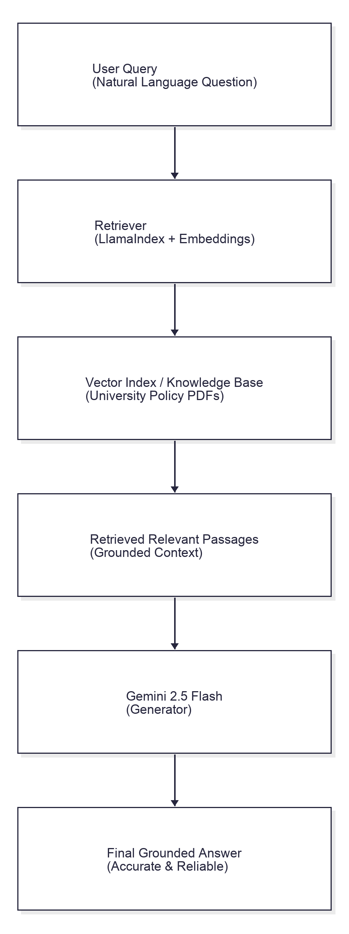
System Design: System Architecture

Slide 9
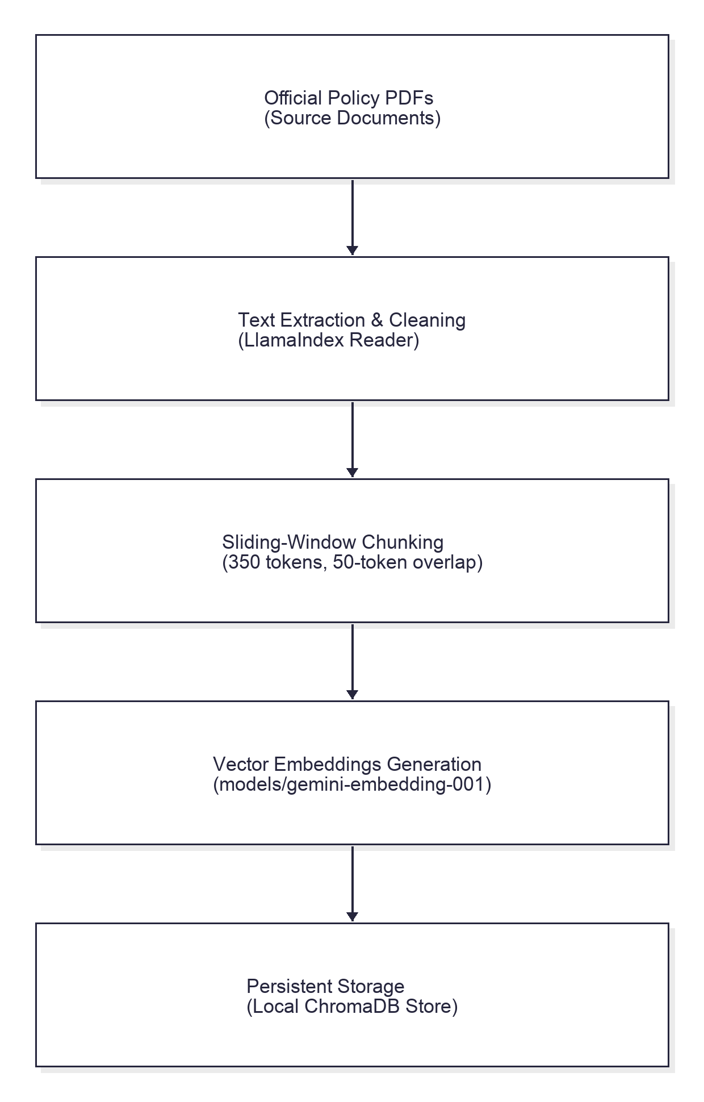
Document Processing & Retrieval
System Description:
PDF text extraction from 8 documents
Cleaning, chunking, embedding generation
Vector storage using LlamaIndex

Slide 10
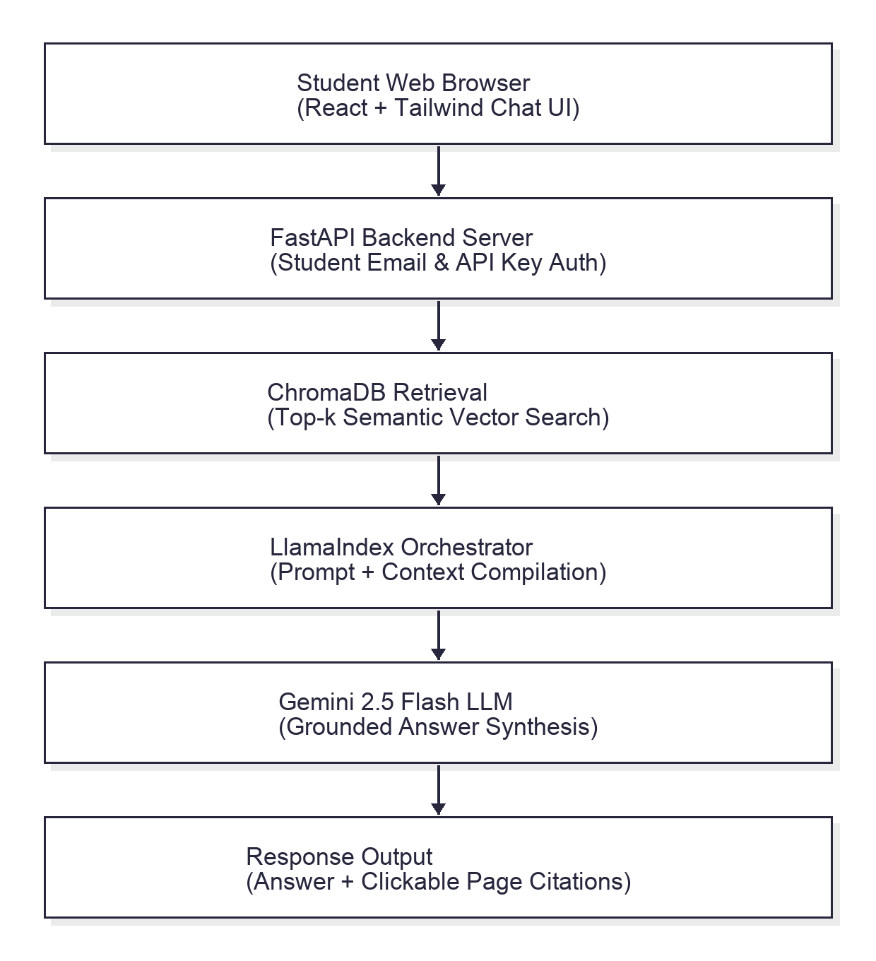
Generation & User Interface
System Description:
Retrieved passages passed as context to Gemini 2.5 Flash
Generates natural, accurate answers
Web interface for natural language queries

Slide 11
Technology Stack
Programming Language: Python 3.10
Core Libraries: LlamaIndex, Google Gemini API Gemini 2.5 Flash, FastAPI
Frontend: Simple web interface (React (Vite) + Tailwind CSS)

Slide 12
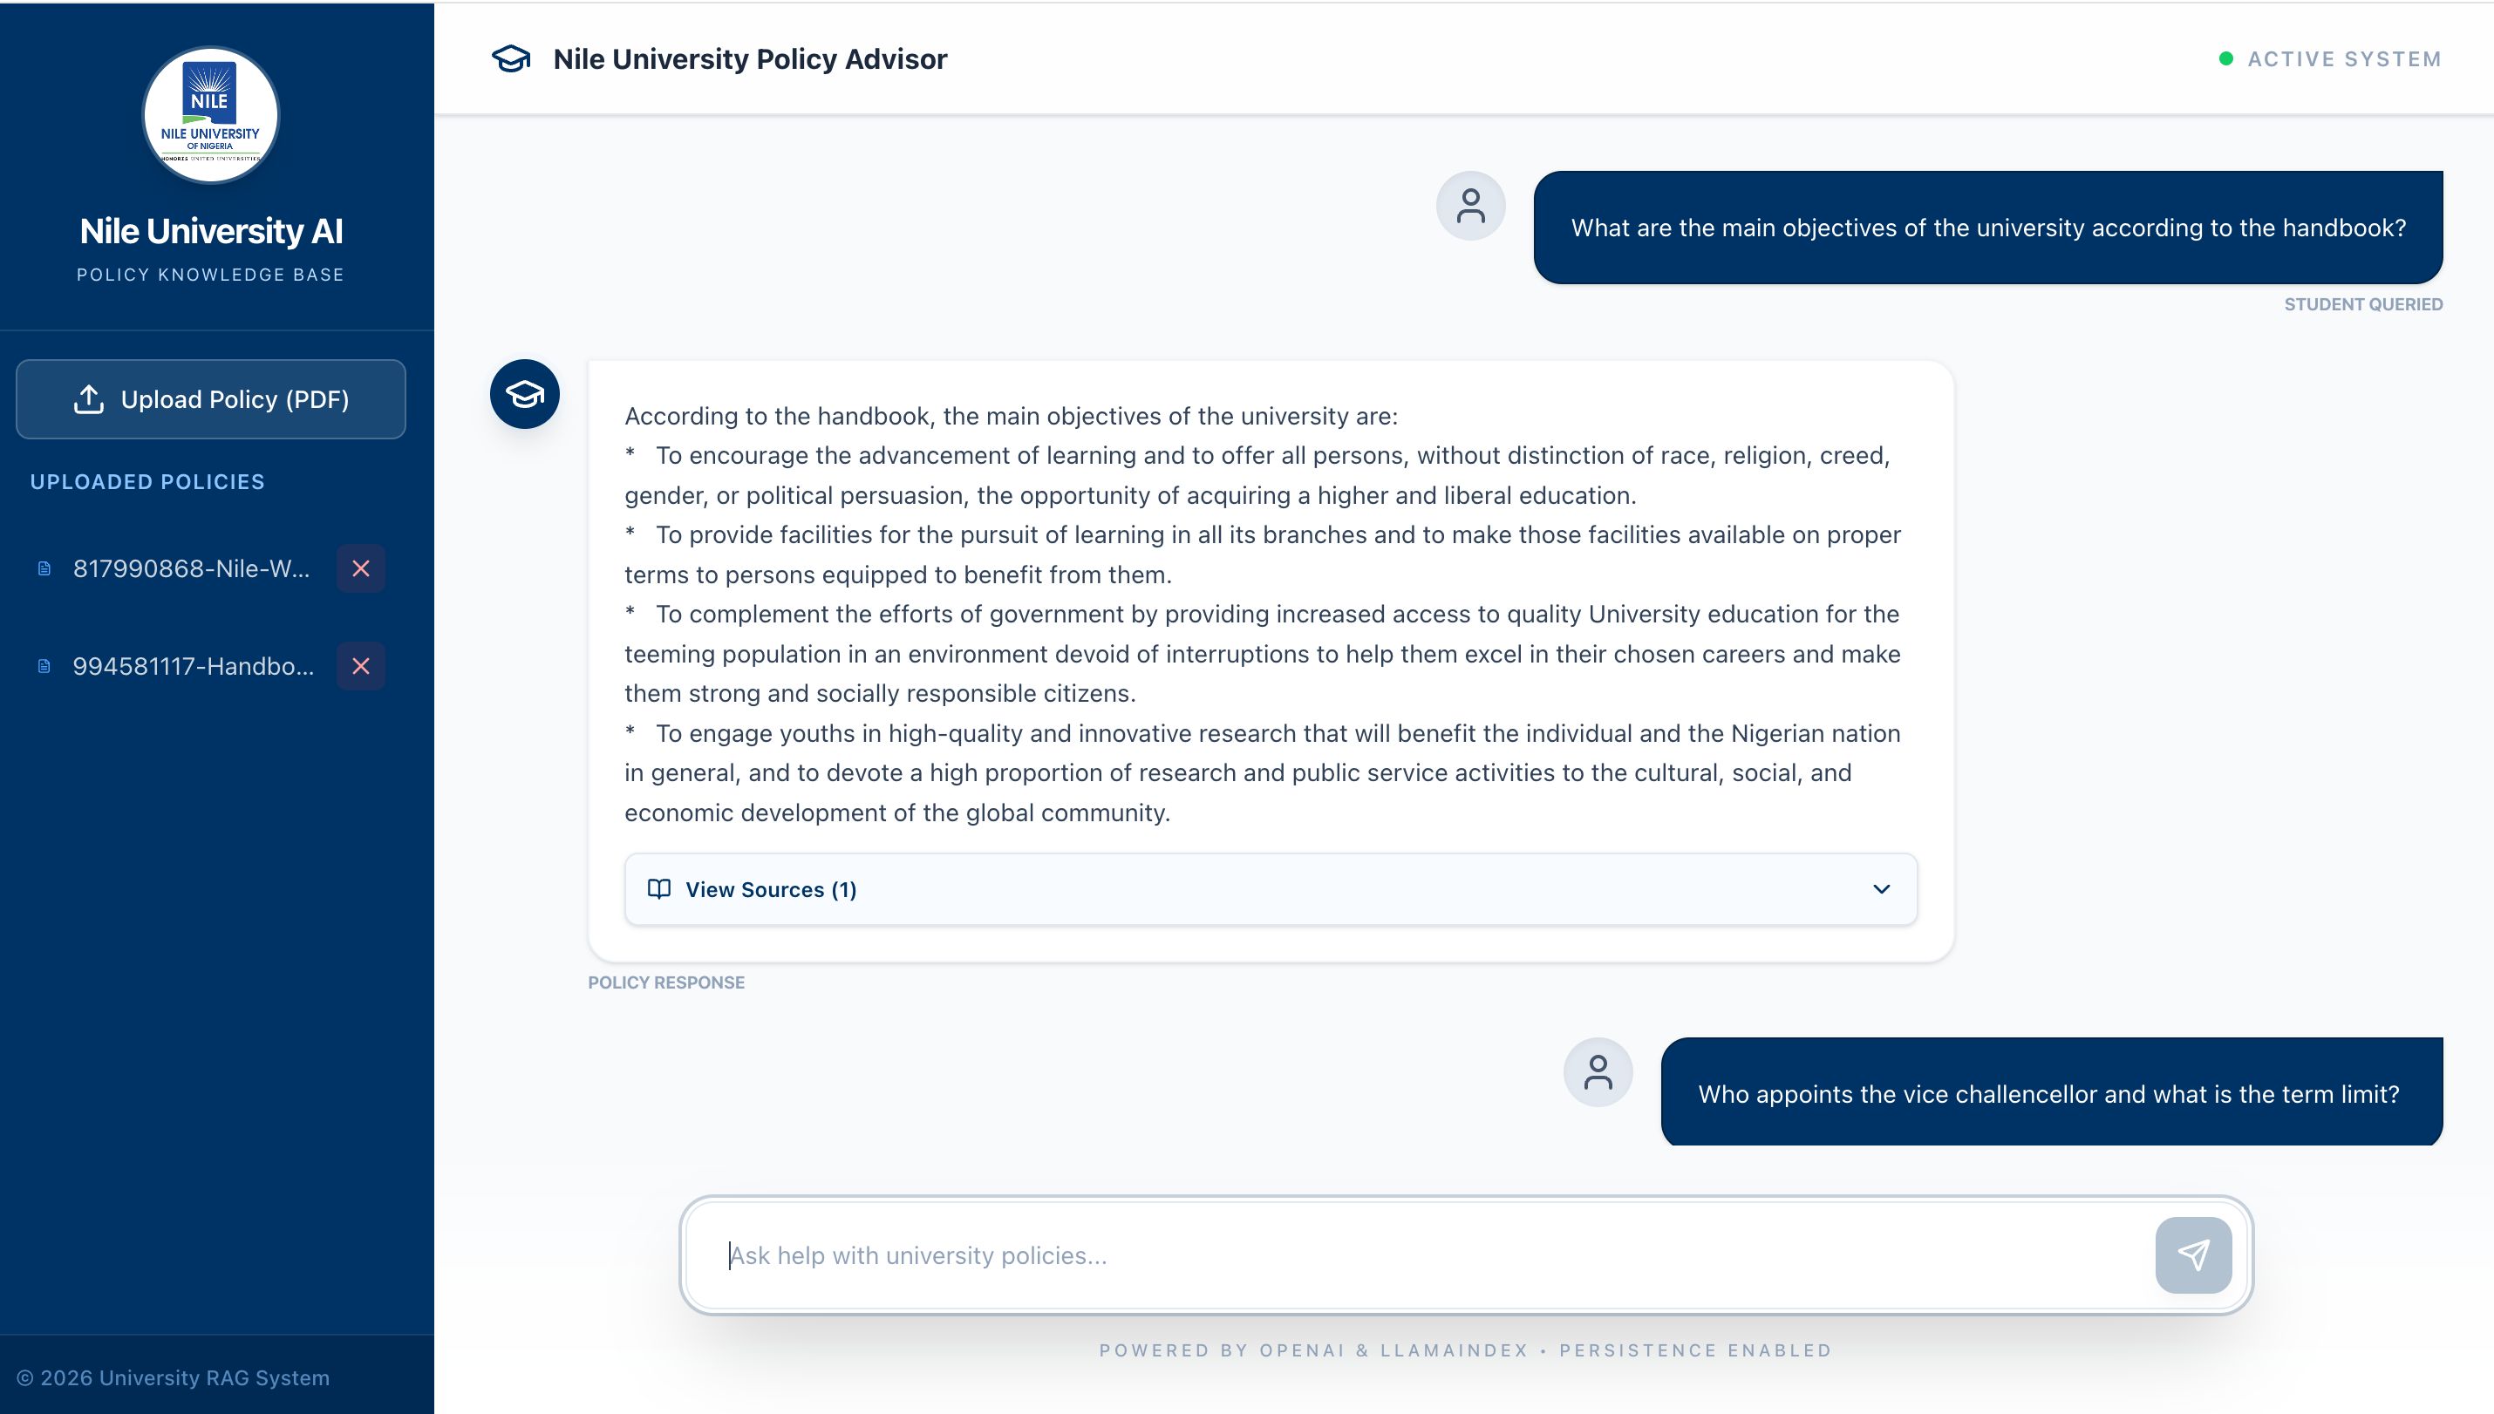
Demo

Slide 13
Conclusion and Future Recommendations
Conclusion
Successfully built a practical RAG-based QA system.
Demonstrated the value of RAG for institutional policy documents.
Future Recommendation
Mobile application development
Voice interface support
Automatic policy update detection
Deployment as a university-wide service

